Slide 1
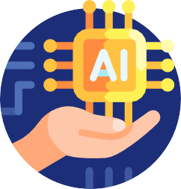


PRESENTATION ON ARTIFICIAL INTELLIGENCE
MADE BY HIMANSHU JAIN STUDENT ID 23091073 BCA SECTION I

Slide 2


Foundations of Artificial Intelligence: Unraveling the Fundamental Principles
MADE BY HIMANSHU JAIN

Slide 3
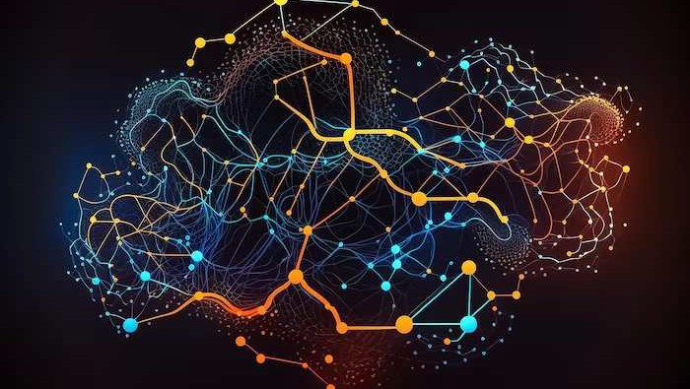
Introduction
Artiﬁcial Intelligence (AI) is the of human
processes by machines. It involves
, reasoning, and self- correction. Join us as we delve into
the foundations of AI.
Add a body text

Slide 4
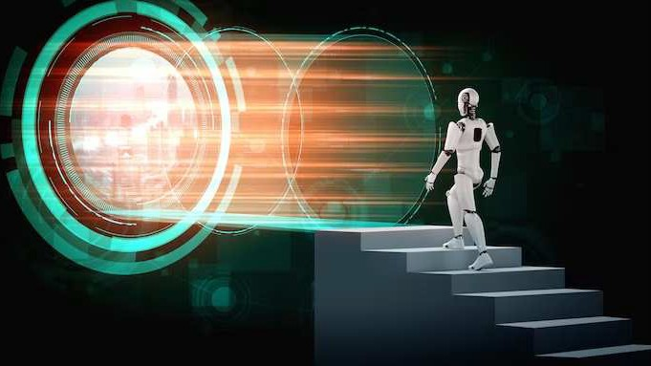


History of AI
The of AI dates back to ancient and philosophy. In the 20th century, the development of
and the birth of
laid the groundwork for AI.

Slide 5


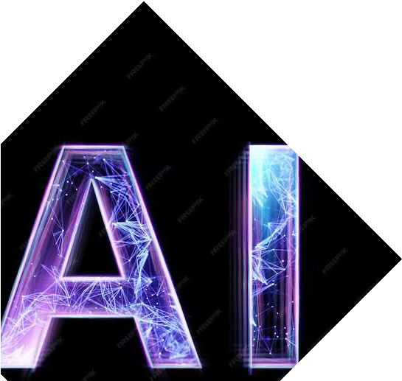
Types of AI
AI can be categorized as
or
and or . Narrow AI is designed for a speciﬁc task, while general AI aims to demonstrate human-like intelligence.

Slide 6



Machine Learning
is a subset of AI that enables machines to learn from data and improve their performance over time. It includes , , and
.

Slide 7

Neural Networks
are a key component of AI, inspired by the structure of the human brain. They consist of interconnected nodes that process and transmit information.

Slide 8
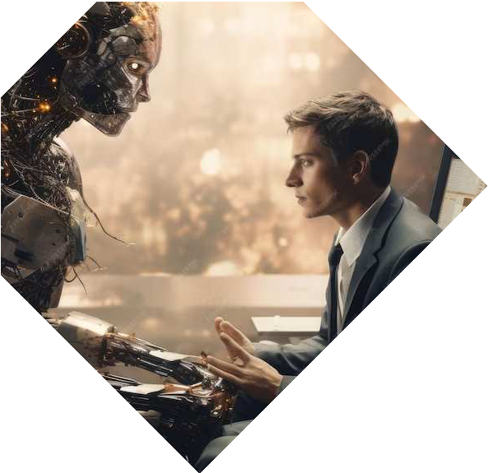


Natural Language Processing
enables machines to understand and interpret human language. It encompasses tasks such as ,
, and .

Slide 9


Ethical Considerations
The rapid advancement of AI raises ethical concerns related to ,
, and . It is
crucial to address these issues to ensure responsible AI development.

Slide 10



AI in Healthcare
AI is revolutionizing healthcare through applications such as ,
, and . It
has the potential to enhance patient care and improve outcomes.

Slide 11



AI in Business
Businesses utilize AI for
,
,
and . It enables
organizations to make data-driven decisions and improve operational eﬃciency.

Slide 12



Challenges and Future
Outlook
The challenges of AI include
, , and
. Looking ahead, AI holds the potential for
and societal
.
MADE BY HIMANSHU JAIN

Slide 13
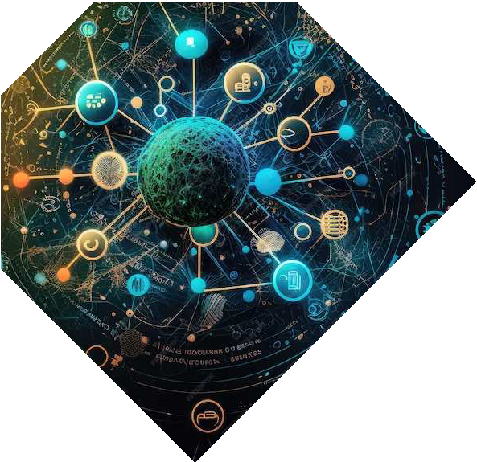

Ethical AI Principles
Adhering to ethical AI principles such as
, , and
is essential for building trust and ensuring
the responsible deployment of AI technologies.

Slide 14


Future of AI Research
The future of AI research will focus on , , and
. These areas
will shape the trajectory of AI development and its impact on
society.

Slide 15
Conclusion
The foundations of AI encompass a rich history, diverse applications, and ethical considerations.
As AI continues to evolve, it is imperative to navigate its development with ethical integrity and a focus on societal beneﬁt.

Slide 16





Thanks!

